Slide 1
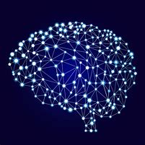
Identification of medicinal plants using deep convolutional networks
Presented By:
1. Vyoma Dixit(170130111022)
2. Parita Brahmbhatt (170130111014)
Guided By: Prof. Suhas Patel

Slide 2
OUTLINE
Introduction
What is Computer Vision?
Convolutional Neural Network?
Flow Diagrams
Tools
Work done till date
Dataset

Slide 3
Introduction
How do we get here?
Leaf Identification is a field under the image recognition of computer vision.
Recognizing leaves is the utmost importance in biodiversity conservation.
According to a survey, 80% of Indians use plants as medicine. Hence, it is an important milestone in conserving not just biodiversity but also helpful for accurate identification.
The implementation of the project will be done using Convolutional Neural Networks.

Slide 4
What is computer vision?
computer vision is concerned with the automatic extraction, analysis and understanding of useful information from a single image or a sequence of images.
- The British Machine Vision Association and Society for Pattern Recognition (BMVA)
It is an interdisciplinary field that deals with how computers can be made to gain high-level understanding from digital images or videos.
- Wikipedia

Slide 5
Convolution neural network
It is a class of deep learning.
CNN is one of the main categories used for image recognition, image classification, object detection, and face recognition.
It is similar to basic neural network. CNN has learnable parameter like neural network.
3 basic components of CNN: Convolutional layer, Pooling layer and Output layer or Fully connected layer.

Slide 6
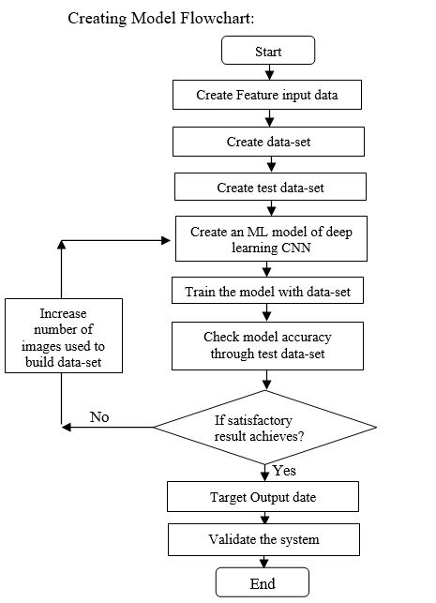
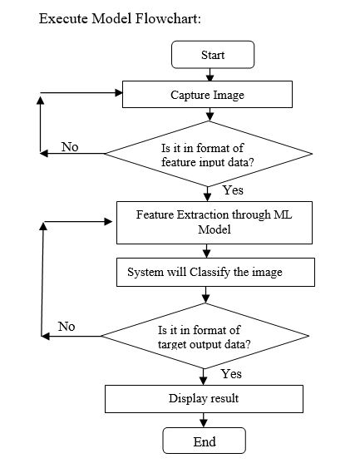
Flow diagrams

Slide 7
tools
Python:
It has strong attributes. Python is very suitable for implementing new ideas. Python is most commonly used for machine learning since its has vast number of open source library.
Python has a bigger community. Therefore there are lots of online resources regarding Python.
Python Image Manipulation tools:
NumPy: It is a core library and provides support for arrays.
SciPy: It is a core scientific library which is used for basic image manipulation and processing tasks.
Keras: It provides a Python interface for artificial neural networks. It works on the top of Tensorflow seamlessly to create efficient deep learning models.

Slide 8
Work done till date
Literature survey
Started creating a data set of Indian Medicinal Plants
Wrote a review paper
Working on a basic program

Slide 9
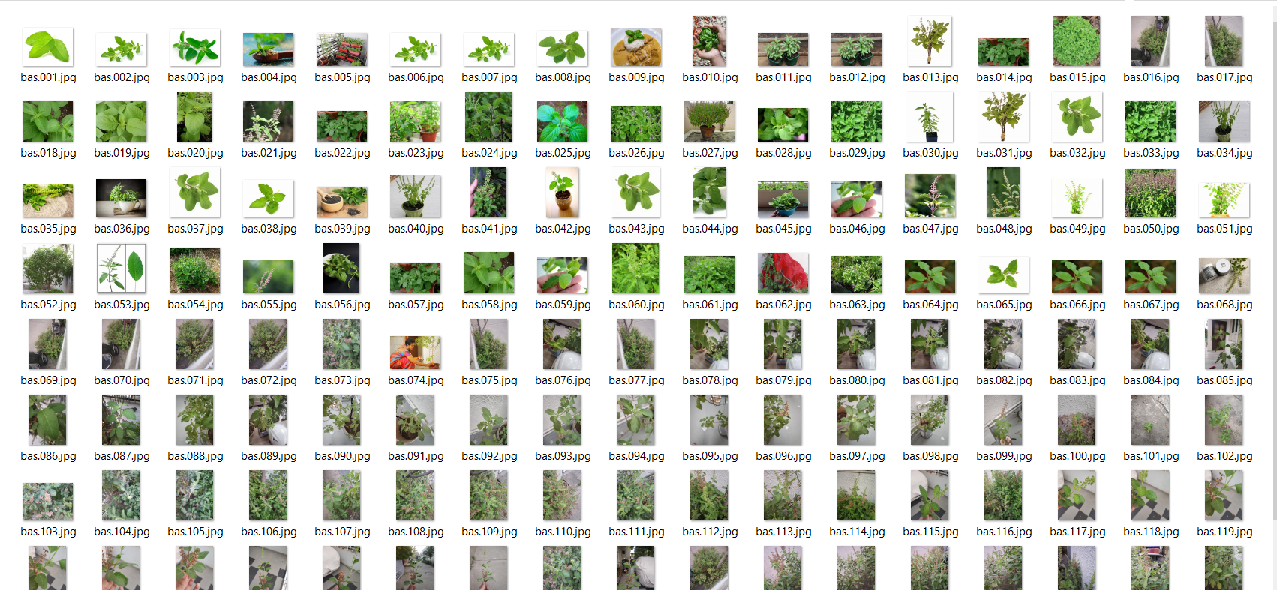
dataset

Slide 10
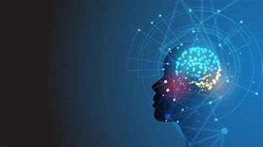
THANK YOU!

